Slide 1

POWER BI PROJECT DATASET:-CLASSICAL MODEL
The goal of the capstone project is to design and implement a BI solution using PowerBI and SQL that can help the company manage and analyze their sales data effectively. The solution should be able to:-
Import and integrate the data from MySQL database into PowerBI Watch this video to know how to connect MYSQL database to PowerBI
Clean and transform the data to make it ready for analysis.
Build interactive dashboards and reports using PowerBI that can help the sales team and management make sense of the data.
Use SQL to perform advanced analytics on the data and extract insights that can help the company improve its sales (if needed).
Enable the management to access the dashboards and reports in real-time and make data-driven decisions.
……………………………………………………………………MD DANISH KHAN

Slide 2
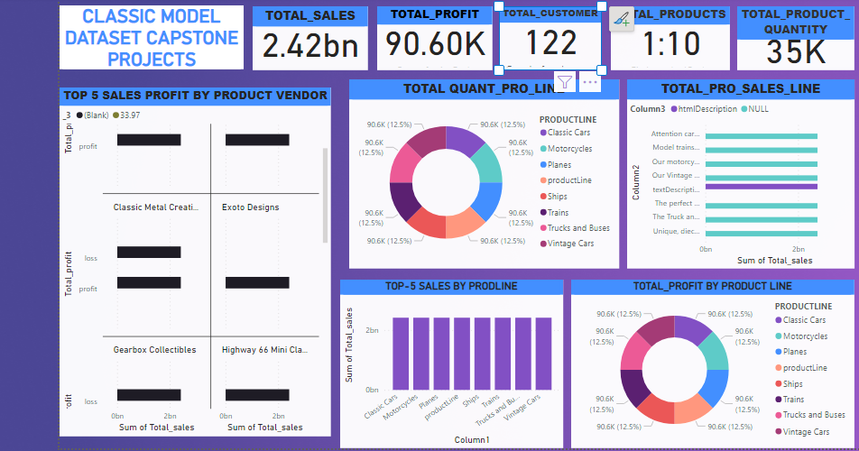

Slide 3
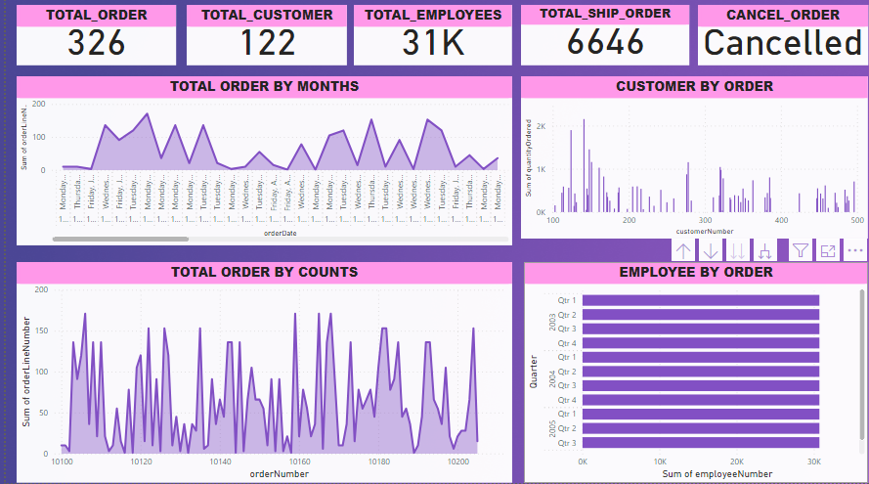

Slide 4
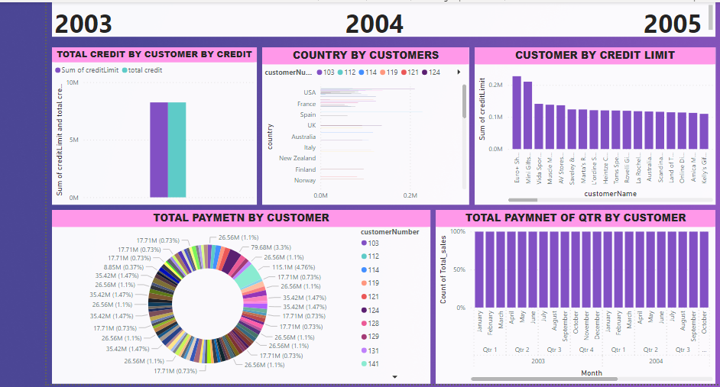

Slide 5
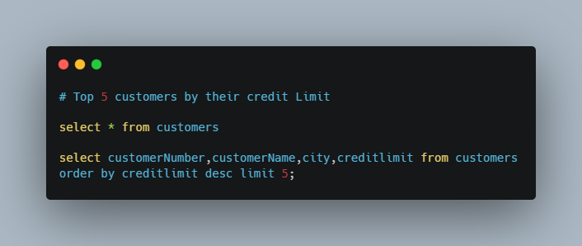
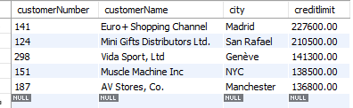
Top 5 customers their credit limit

Slide 6
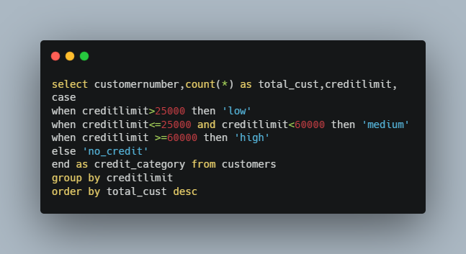
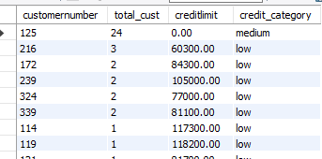
Customer count based on credit categories

Slide 7
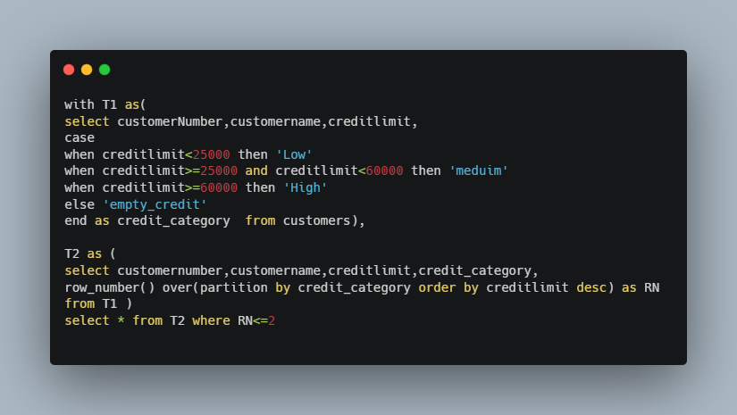
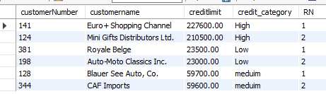
Customers and their credit limit under each credit category.

Slide 8
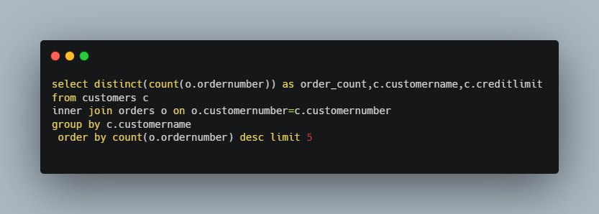
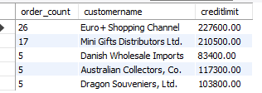
Orders placed by Top 5 customers.

Slide 9
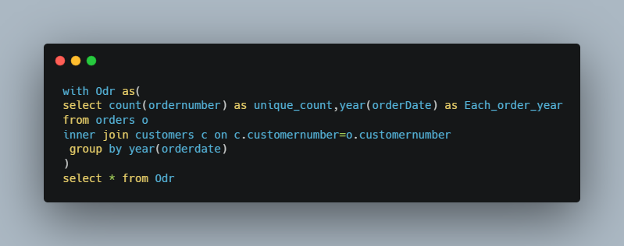

Order count for each year

Slide 10
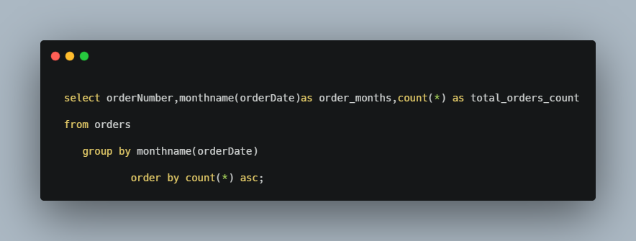
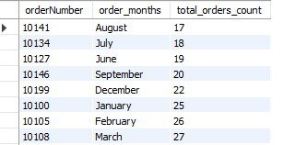
Monthly Order count for all three years.

Slide 11
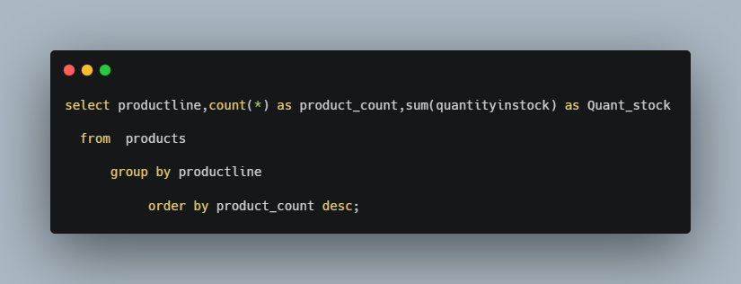
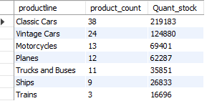
Product count by productLine.

Slide 12
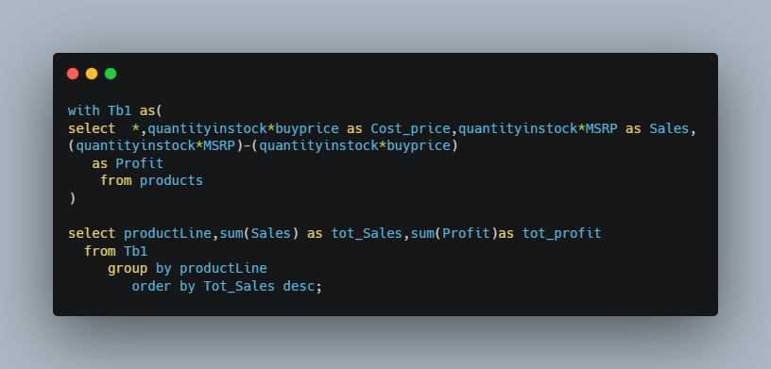
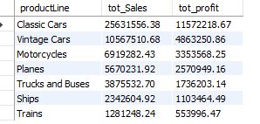
Total sales and profit by productLine.

Slide 13
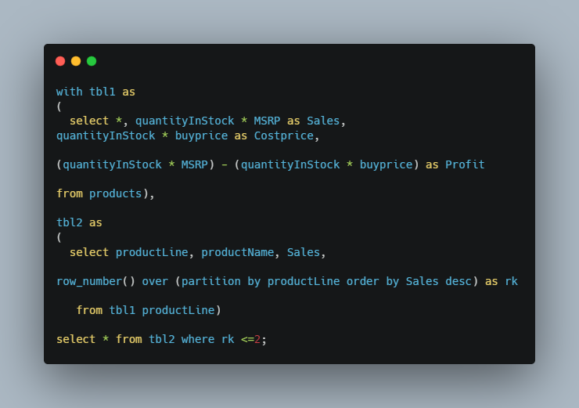
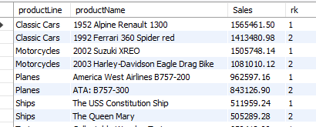
Top 2 sales by productLine with productname

Slide 14
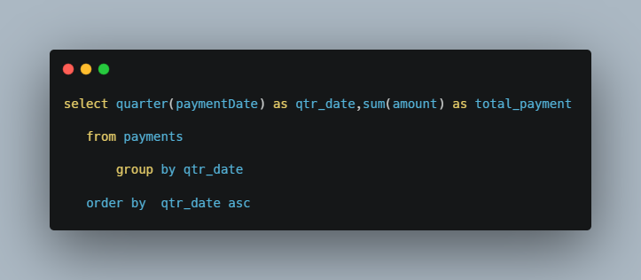

Quarterly payments for all three years

Slide 15
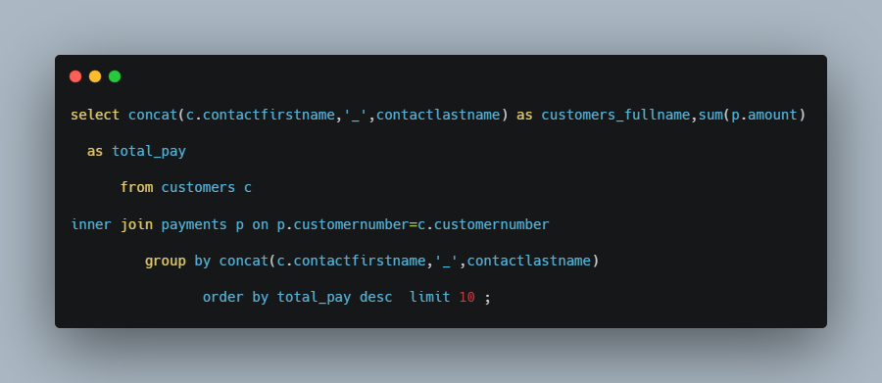
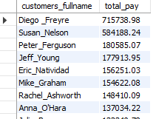
Top 10 payments by customername

Slide 16
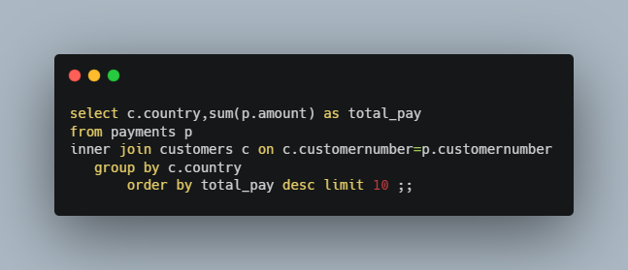
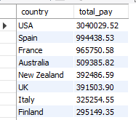
Top 10 payments by country

Slide 17
Summary:- The Classic Models database is a sample database that is often used for educational and demonstration purposes in the context of MySQL. It represents a fictitious company that imports scale model cars from various manufacturers around the world. Tables: The Classic Models database typically consists of the following tables: Customers: Stores information about the customers who purchase the scale model cars. Employees: Contains details about the employees of the company. Offices: Stores information about the different offices of the company in different cities. OrderDetails: Contains details about the products ordered by the customers. Orders: Stores information about the orders placed by the customers. Payments: Contains details about the payments made by customers. ProductLines: Stores information about the product lines or categories of scale model cars. Products: Contains details about the individual products or scale model cars. The tables in the Classic Models database are linked together through various relationships, such as foreign key relationships between tables like Orders and Customers, Orders and OrderDetails, Employees and Offices. This database is often used as a learning tool to demonstrate various SQL queries, data manipulation techniques, and database management operations, including retrieving data, inserting data, updating data, and deleting data, among others.

